Slide 1
A List Implementation that Uses An Array
Chapter 13
Data Structures and Abstractions with Java, 4e
Frank Carrano
© 2015 Pearson Education, Inc., Upper Saddle River, NJ. All rights reserved.

Slide 2
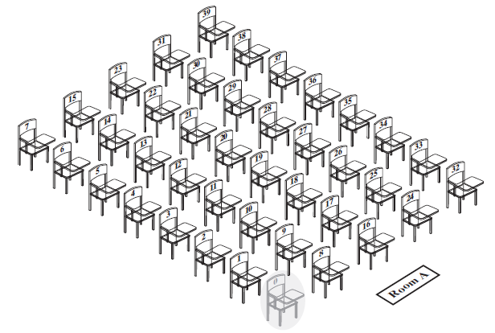
Array to Implement the ADT List
FIGURE 13-1 A classroom that contains
desks in fixed positions
© 2015 Pearson Education, Inc., Upper Saddle River, NJ. All rights reserved.

Slide 3
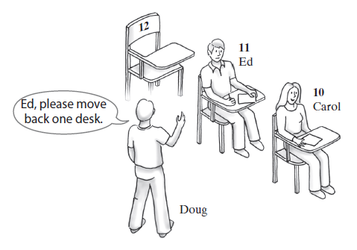
Array to Implement the ADT List
FIGURE 13-2 Seating a new student between two existing students: At least one other student must move
© 2015 Pearson Education, Inc., Upper Saddle River, NJ. All rights reserved.

Slide 4
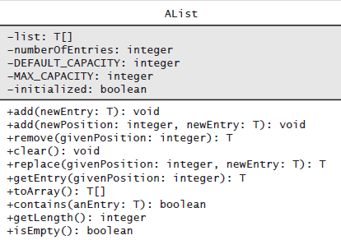
Array to Implement the ADT List
FIGURE 13-3 UML notation for the class AList
© 2015 Pearson Education, Inc., Upper Saddle River, NJ. All rights reserved.

Slide 5
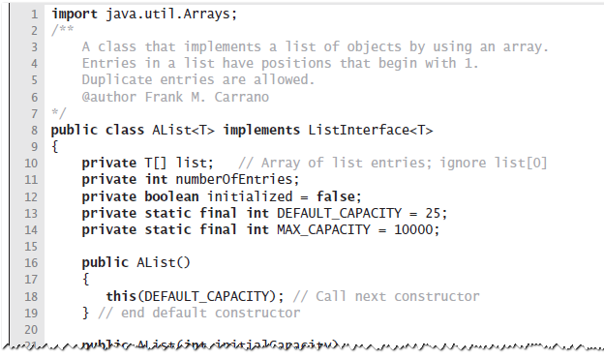
Array to Implement the ADT List
LISTING 13-1 The class AList
© 2015 Pearson Education, Inc., Upper Saddle River, NJ. All rights reserved.

Slide 6
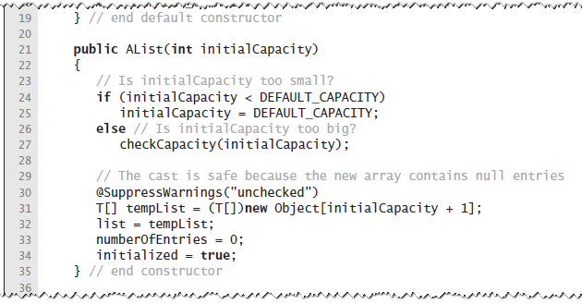
Array to Implement the ADT List
LISTING 13-1 The class AList
© 2015 Pearson Education, Inc., Upper Saddle River, NJ. All rights reserved.

Slide 7
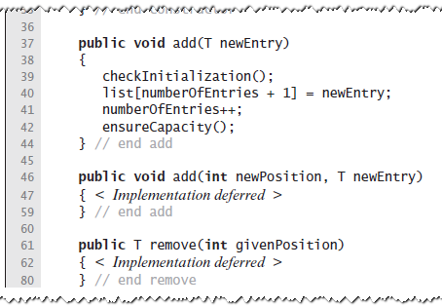
Array to Implement the ADT List
LISTING 13-1 The class AList
© 2015 Pearson Education, Inc., Upper Saddle River, NJ. All rights reserved.

Slide 8
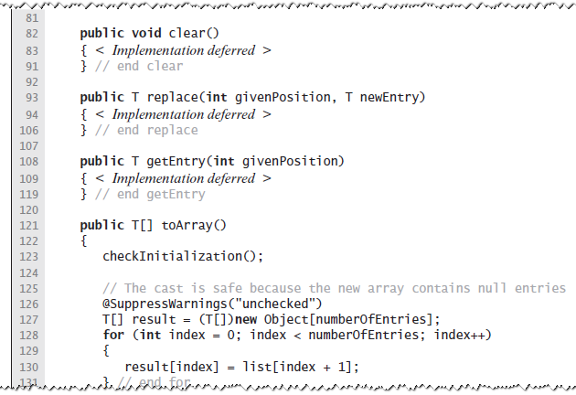
Array to Implement the ADT List
LISTING 13-1 The class AList
© 2015 Pearson Education, Inc., Upper Saddle River, NJ. All rights reserved.

Slide 9
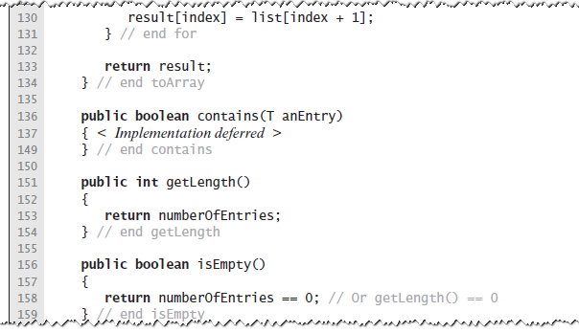
Array to Implement the ADT List
LISTING 13-1 The class AList
© 2015 Pearson Education, Inc., Upper Saddle River, NJ. All rights reserved.

Slide 10
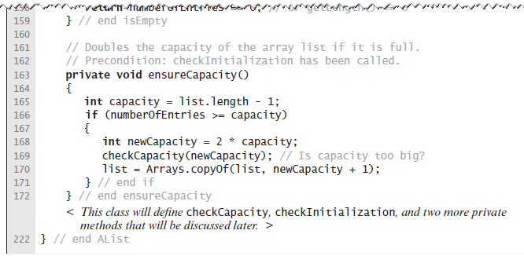
Array to Implement the ADT List
LISTING 13-1 The class AList
© 2015 Pearson Education, Inc., Upper Saddle River, NJ. All rights reserved.

Slide 11
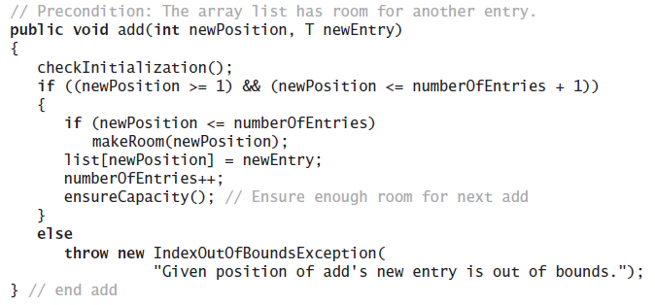
Array to Implement the ADT List
Implementation of add uses a private method makeRoom to handle the details of moving data within the array
© 2015 Pearson Education, Inc., Upper Saddle River, NJ. All rights reserved.

Slide 12
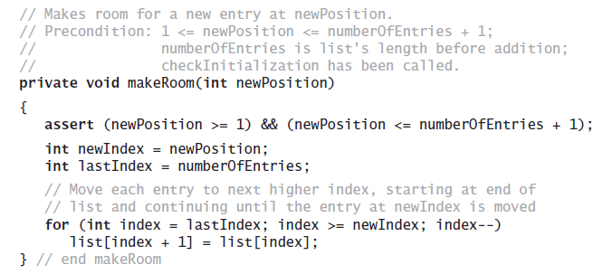
Array to Implement the ADT List
Implement the private method makeRoom
© 2015 Pearson Education, Inc., Upper Saddle River, NJ. All rights reserved.

Slide 13
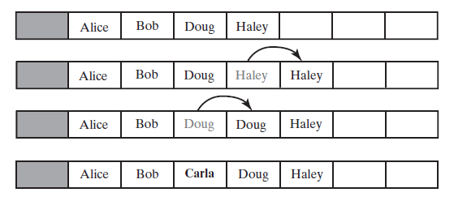
Array to Implement the ADT List
FIGURE 13-4 Making room to insert
Carla as the third entry in an array
© 2015 Pearson Education, Inc., Upper Saddle River, NJ. All rights reserved.

Slide 14
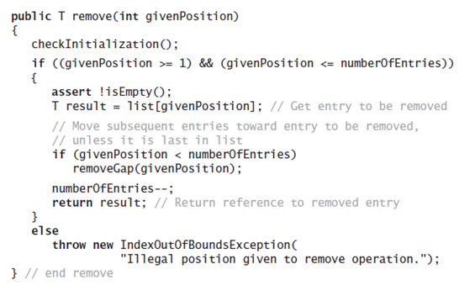
Array to Implement the ADT List
Implementation uses a private method removeGap to handle the details of moving data within the array.
© 2015 Pearson Education, Inc., Upper Saddle River, NJ. All rights reserved.

Slide 15
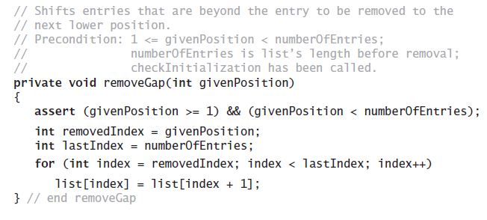
Array to Implement the ADT List
Method removeGap shifts
list entries within the array
© 2015 Pearson Education, Inc., Upper Saddle River, NJ. All rights reserved.

Slide 16
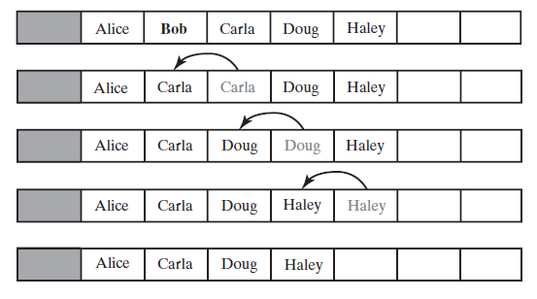
Array to Implement the ADT List
FIGURE 13-5 Removing Bob by shifting array entries
© 2015 Pearson Education, Inc., Upper Saddle River, NJ. All rights reserved.

Slide 17
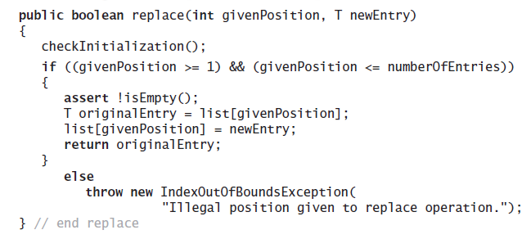
Array to Implement the ADT List
Method replace
© 2015 Pearson Education, Inc., Upper Saddle River, NJ. All rights reserved.

Slide 18
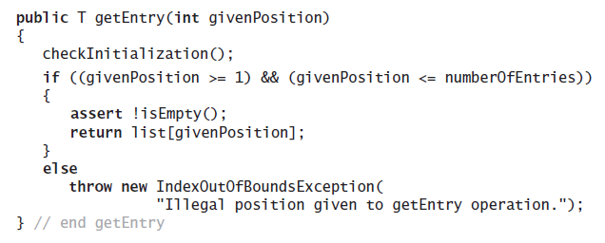
Array to Implement the ADT List
Method getEntry
© 2015 Pearson Education, Inc., Upper Saddle River, NJ. All rights reserved.

Slide 19
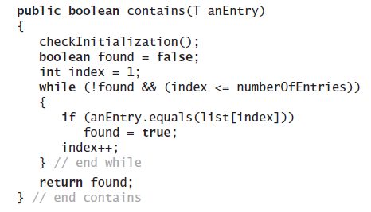
Array to Implement the ADT List
Method contains uses a local boolean variable to terminate the loop when we find the desired entry.
© 2015 Pearson Education, Inc., Upper Saddle River, NJ. All rights reserved.

Slide 20
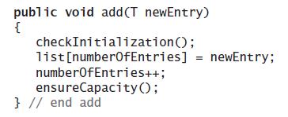
Array to Implement the ADT List
Operation that adds a new entry to the end of a list.
Efficiency O(1) if array is not resized.
© 2015 Pearson Education, Inc., Upper Saddle River, NJ. All rights reserved.

Slide 21
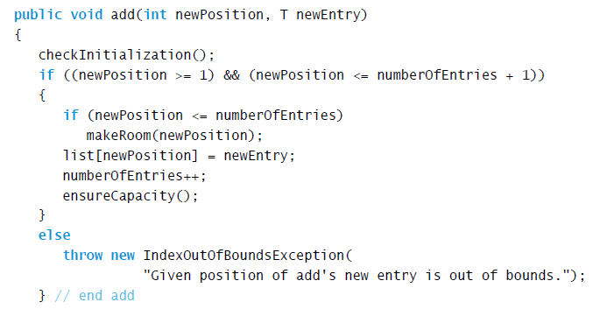
Array to Implement the ADT List
Add a new entry to a list at a client-specified position.
© 2015 Pearson Education, Inc., Upper Saddle River, NJ. All rights reserved.

Slide 22
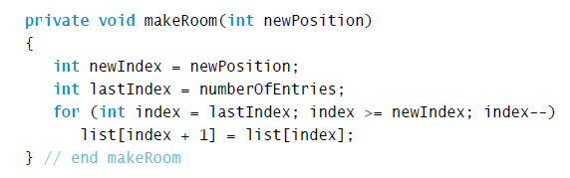
Array to Implement the ADT List
Method add uses method makeRoom.
© 2015 Pearson Education, Inc., Upper Saddle River, NJ. All rights reserved.

Slide 23
End
Chapter 13
© 2015 Pearson Education, Inc., Upper Saddle River, NJ. All rights reserved.

